Slide 1
Calories Burned prediction
Abdallah Hamdy Shaban 2021/10678 abdallah2110678@miuegypt.edu.eg
Daniel Michel 2021/01026 instructor: Diaa AbdelMoneim
daniel2101026@miuegypt.edu.eg
Abdulrahman Abdalmoniem Ahmed 2021/11656
abdulrahman2111656@miuegypt.edu.eg
Mohamed Ahmed Mohamed Aboushosha 2021/10111
mohamed2110111@miuegypt.edu.eg
Ahmed Khaled Maher 2020/03973
Ahmed2003973@miuegypt.edu.eg

Slide 2
Agenda
Introduction
Dataset
Methodology
Results
Conclusion
Acknowledgment

Slide 3
Introduction
In today's fast-paced world, maintaining a healthy lifestyle amid busy schedules remains a challenge. The crucial role of regular exercise in health prompts the quest for efficient workout strategies. This study delves into the realm of machine learning to address this challenge. Our aim is to predict post-exercise calorie burn accurately. Leveraging various powerful algorithms such as Linear Regression, Decision Tree Regressor, Random Forest Regressor, AdaBoost Regressor, Gradient Boosting Regressor, and XGBoost Regressor, we seek to optimize predictions and provide a solution that tailors fitness regimes for individuals, maximizing outcomes with minimal time investment

Slide 4
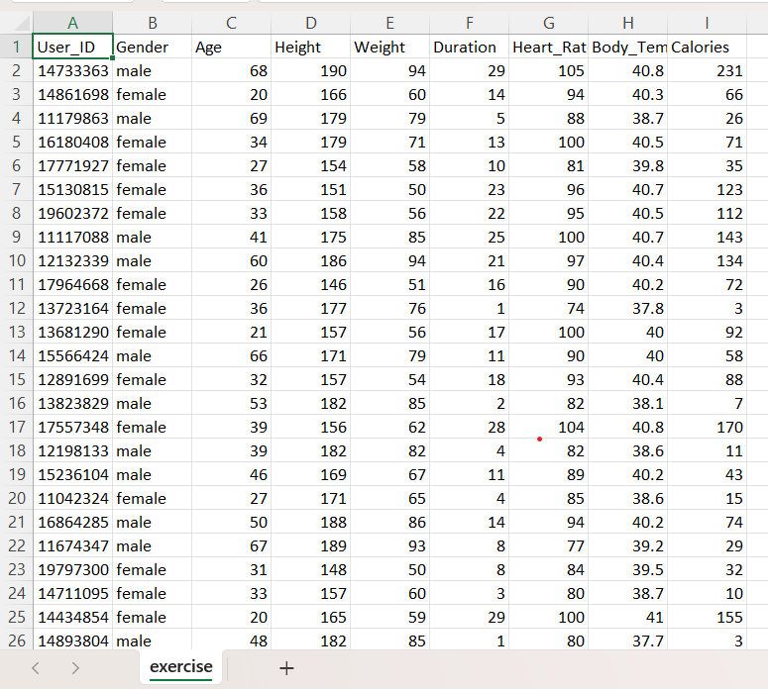
Dataset

Slide 5
Used Algorithms
1: Linear Regression 2: Decision Tree Regressor 3: Random Forest Regressor 4: AdaBoost Regressor 5:Gradient Boosting Regressor 6: XGBoost Regressor

Slide 6
Linear Regression
is a supervised learning algorithm employed for predictive modeling in which the relationship between a dependent variable and one or more independent variables is modeled as a linear equation. It assumes a linear relationship between the input features and the output, attempting to find the "best-fit" line that minimizes the difference between predicted and actual values. This model predicts continuous numeric outcomes and is particularly useful in scenarios where understanding and quantifying the relationship between variables is essential. The algorithm's output is a straight line that best represents the relationship between the independent variables and the target variable, making it a foundational tool in regression analysis.

Slide 7
Decision Tree Regressor
is a versatile supervised learning algorithm used for both classification and regression tasks. It builds a tree-like structure where each internal node represents a feature or attribute, each branch signifies a decision or rule based on that feature, and each leaf node represents the outcome or predicted value. The algorithm makes decisions by following the tree from the root node to the leaf node based on the input features. It's known for its interpretability, as it mimics human decision-making processes by breaking down complex decision-making into a series of simple decisions based on features. Decision Trees are robust, handle both numerical and categorical data, and are capable of capturing non-linear relationships between features and the target variable. They're particularly useful for understanding feature importance and visualizing decision-making paths within the data.

Slide 8
Random Forest Regressor
Random Forest Regressor constructs multiple decision trees during training and outputs the average prediction of individual trees for regression tasks. It operates by creating a "forest" of decision trees, each trained on random subsets of the training data and random subsets of the features. This randomness during training helps in reducing overfitting and improving generalization. When making predictions, each tree in the forest independently predicts the output, and the final prediction is the average (or mean) of these individual tree predictions. Random Forest Regressor is known for its robustness, ability to handle high-dimensional data, and capability to capture complex relationships between features and target variables while reducing the risk of overfitting that can occur with individual decision trees.

Slide 9
AdaBoost Regressor
AdaBoost, short for Adaptive Boosting, is an ensemble method that combines multiple weak learners into a strong predictor. In regression, it constructs a series of models (often decision trees) sequentially, assigning higher weights to instances that were poorly predicted by preceding models. The subsequent models focus more on the mispredicted instances, continuously improving the overall prediction. Each model's prediction is weighted based on its performance, and the final prediction is a weighted sum of the individual models' predictions. AdaBoost Regressor adapts to the complexities of the dataset, emphasizing previously mispredicted instances to enhance the overall predictive accuracy, making it robust and effective in capturing intricate patterns within the data.

Slide 10
Gradient Boosting Regressor
Gradient Boosting Regressor is an ensemble method that builds a sequence of decision trees, where each subsequent tree corrects the errors of its predecessors. It works by initially creating a simple model and then sequentially building additional models, each one focusing on the mistakes made by the previous model. Rather than training trees independently, it uses gradients (derivatives) of the loss function to minimize errors in prediction. This iterative process helps to gradually improve accuracy by combining weak models into a strong predictor. Gradient Boosting Regressor excels in capturing complex patterns in data and is known for its effectiveness in achieving high predictive accuracy, making it a powerful tool for regression tasks.

Slide 11
XGBoost Regressor
XGBoost Regressor is an enhanced version of Gradient Boosting that focuses on computational speed and model performance. It uses a more regularized model formulation to control overfitting and enables parallel processing to boost training speed. XGBoost incorporates advanced regularization techniques and employs a gradient boosting framework to create an ensemble of weak prediction models. It systematically combines these weak models to produce a robust and accurate final prediction. This algorithm is known for its efficiency, scalability, and ability to handle diverse datasets, making it a popular choice for regression tasks where accuracy and speed are crucial.

Slide 12
Results
AdaBoost Regressor:
Mean Squared Error: 140.61
Root Mean Squared Error: 11.86
R-squared: 0.96
Mean Absolute Error: 9.48
Gradient Boosting Regressor:
Mean Squared Error: 13.94
Root Mean Squared Error: 3.73
R-squared: 0.996
Mean Absolute Error: 2.67
XGBoost Regressor:
Mean Squared Error: 4.81
Root Mean Squared Error: 2.19
R-squared: 0.999
Mean Absolute Error: 1.51
Linear Regression:
Mean Squared Error: 128.20
Root Mean Squared Error: 11.32
R-squared: 0.97
Mean Absolute Error: 8.36
Decision Tree Regressor:
Mean Squared Error: 29.51
Root Mean Squared Error: 5.43
R-squared: 0.99
Mean Absolute Error: 3.49
Random Forest Regressor:
Mean Squared Error: 8.17
Root Mean Squared Error: 2.86
R-squared: 0.998
Mean Absolute Error: 1.78

Slide 13
Conclusion
The XGBoost Regressor exhibits the best overall performance among the algorithms based on the provided metrics. It showcases the lowest MSE, RMSE, and MAE, indicating superior predictive accuracy and smaller errors in comparison to other models.

Slide 14
Thank you

